Slide 1


Anti-virus film
The anti-virus silver film is effective in killing bacteria and viruses including COVID19. Silver is a proven material for deactivating bacteria and viruses. Thus, the film reduces the ability of virus and bacteria being transmitted through a surface being touched or handled by one person and then another.
The anti-virus film is intended to be used in an environment where there is exposure to bacteria and virus. It is adhered to surfaces that may be exposed (directly or indirectly) to bacteria and virus.
This film is applied to the screens of Bayer medical equipment and control units (Salient, Stellant and Stellant Flex).

Slide 2
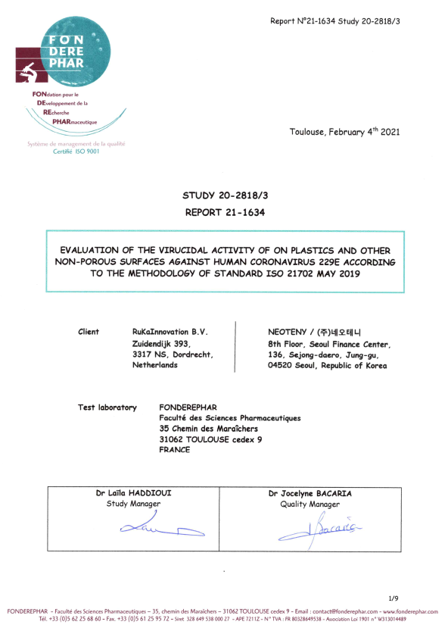
Proven Efficacy - ISO 21702 (tested in Fonderephar Lab)
The film kills 99.9% of influenza virus including H1N1 and COVID19 within 30 minutes of contact time. Exposed surfaces remain virus free when tested again at one hour and then at twenty four hours.
The film also kills bacteria such as Escherichia coli, Staphylococcus Aureus, Klebsiella pneumoniae, Salmonella typhimurium within a ten minute time frame of exposure.

Slide 3
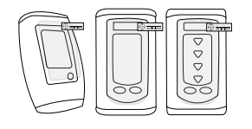
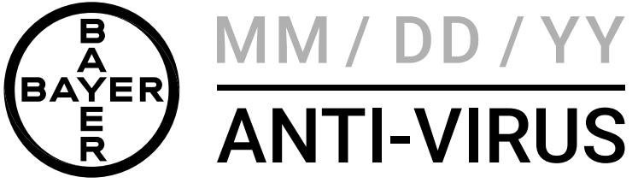
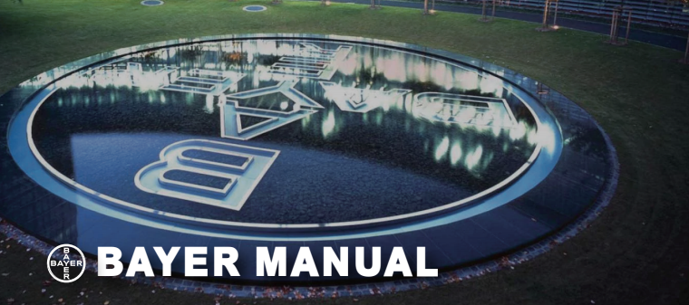
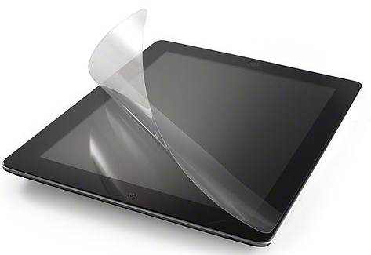
Tailor-made for Bayer
All products are customised for Bayer’s requirements and preference and maintain the highest quality.
Customisation:
- Size
- Thickness
- Release film construction
- Printing
- Packaging
- User manual

Slide 4




Sustainability
For better environment,
- Packaging made of sugarcane based on the standards of
"No Timer", "No Bleach", and "Biodegradable"
- Biodegradable plastic bag inside the packaging
For better society,
- Partnership with the environmental organisations;
World Wide Fund for Nature
Greenpeace
The Climate Reality Project
- 1% of profits go to the partners

