Slide 1
iWorld
A VR Platform that
Can Happen Anything
Terrence Zhang
&
Jerry Ning

Slide 2
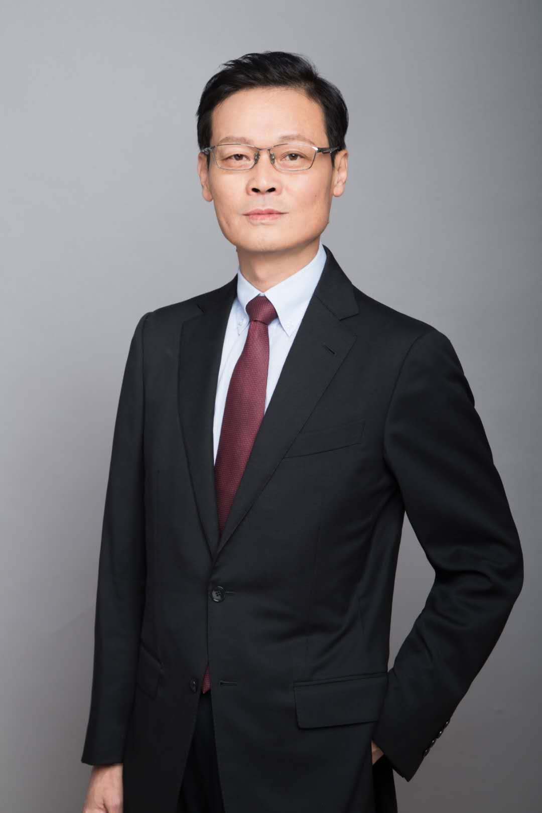





团队介绍
王晓清
亚洲著名GIS专家
iWorld 技术顾问
Terrance Zhang
iWorld Founder
李凯
iWorld CFO
CPA
Investment Bank Sponsor
Certificated Lawyer
邹亦刚
iWorld CAO
Jerry Ning
iWorld Co-Founder
Cheng Chen
iWorld Managing
Director

Slide 3















Business Model
1
Platform
We are establishing a platform of future virtual “real” world where customers can consume virtual goods.
2
Contributors and Property ownership
iWorld eco-system needs more participants to build up. There are basically three kinds of contributors: (1) data contributors, (2) storage contributors, (3) vertical applications developers. All contributions are rewarded by AND tokens.
The map data uploaders has the initial ownership of the virtual properties, and they can sell the ownership on the virtual mall.
3
Merchants and Consumers
Real-world bricks-and mortar merchants are able to enter iWorld to do business.
iWorld is a free platform to all general customers. However, if consumers want to experience more superior services and experience, they have to pay AND Points.
4
Virtual mall
Virtual mall offers a huge amount of virtual goods such as clothing, weather system, transportation, private properties, time machine, etc..
A.P.I.
5
Exchange and Bancor
Contributors and consumers can sell and but AND tokens on exchange, while Bancor offers seamless convertibility between AND and AND Points.

Slide 4
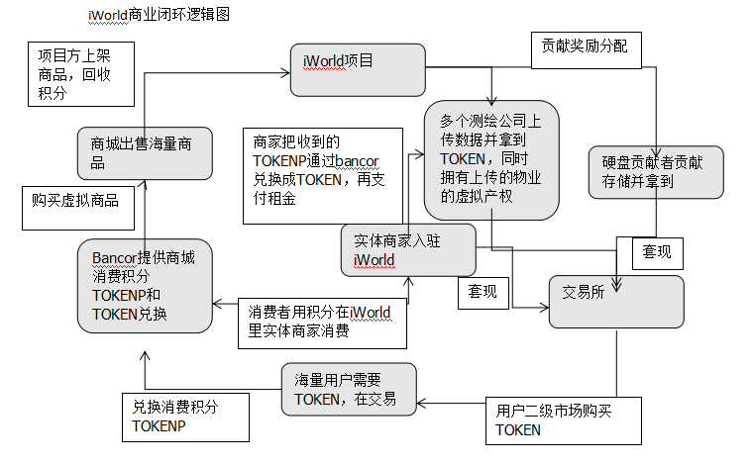
1，iWorld项目方推出该虚拟现实的庞大世界及世界观给客户，客户可以在iWorld里通过VR、AR、MR或者其他显示设备接触到一切现实世界、虚拟世界、增强虚拟世界的优秀体验。
2，iWorld的世界过于宏大，需要多个数据测绘公司作为节点贡献数据，共同搭建。所有上传数据的节点都会获得iWorld世界里唯一通证IWD作为奖励。同时本着谁上传谁拥有该数据所有权的原则，可视化物业数据的产权归上传节点拥有。
3，如此海量的数据需要巨大的硬盘存储，iWorld里所有贡献硬盘存储的节点都会获得相应的IWD作为奖励。
4，数据和存储的贡献者都可以将IWD拿到交易所上套现。
5，另一方面，iWorld项目方会推出种类繁多内容新颖的虚拟商城，商城里有大量限量限季的商品，例如服饰、天气系统、交通工具、私人物业、演唱会门票、时光机等等。消费者如果想要体验这些更高级的服务，必须使用消费积分IWDP在商城里购买。
6，获得消费积分 IWDP的唯一途径就是用IWD在商城下属BANCOR兑换机里进行实时兑换。而获得IWD最快的途径就是去交易所直接购买，形成买盘的中坚力量。
7，现实世界中的实体商家可以入驻iWorld，并iWorld里销售自己的产品，每个客户使用消费积分IWDP购买产品后，商家会在现实世界邮寄真实商品给客户。商家可以把收到的积分IWDP通过Bancor兑换成通证IWD，一部分拿到交易所套现，一部分拿来支付虚拟房租。
8，在整个商业闭环之外，还会出现一批用户，他们并不使用iWorld平台的任何服务，只是单纯地看重IWD的上涨价值，于是会在交易所二级市场购买IWD。因此我们的交易所的交易深度可以得到保障。

Slide 5







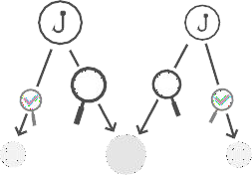
iWorld potentialmarket
iWorld plans to occupy 3% of the movie market, 15% of AR and VR markets, 2% of the game market and 5% of the online retail market by 2021. The total amount of these four major markets is about 276.14 billion U.S. dollars around 2021.
V
Film industry
the TOP 11 markets generated more than
32.61 billion U.S. dollars in 2018 and we estimate this number will increase to nearly 45 billion U.S. dollars in 2020. China was the second largest market in 2018, with a box office revenue of 9.15 billion U.S. dollars that year..
Relay Chain
V
V
V
V
Game market
We expect that consumers spend on games will grow to $180.1 billion by 2021, a CAGR of +10.3% between
2017 and 2021. Considering that global games market revenues were
$70.6 billion in 2012, this puts the 10- year CAGR for the market (2012-2021)
at +11.0%.
N
N
N
V
V
V
V
Online retail market
V
In 2017, retail e-commerce sales worldwide amounted to 2.3 trillion US dollars and e-retail revenues are projected to grow to 4.88 trillion US dollars in 2021.
V
V
VR/AR market
FiIt predicts that the combined AR/VR market size will be $178 billion in 2022. The compound annual growth rate (CAGR) of AR market is about 44.5% and the CAGR of AR market is about 85.4% from 2017 to 2022..
!
V
V
V

Slide 6

Pricing role of Bancor in Token Points.
Bancor
1, purpose: it helps users exchange AND to ANDP and then directly purchase goods in iWorld online shopping mall.
2, advantage: Bancor mechanism is intelligent and efficient, and ANDP is directly issued to the users through the pricing formula. The exchange rate between AND and ANDP is automatically adjusted based on the supply and demand of the market, and the whole process is short enough to be ignored.
Basic pricing formula:
Q = S *[(1+ ^{q} )^{L} −1]
B
Q represents the number of ANDPs that can be redeemed this time. S represents the total amount of ANDP circulation in the market.
q represents the number of IWDs used to redeem ANDP. B stands for deposit reserve
L stands for leverage
Reverse pricing formula:
Q = B *(^{L} 1+ ^{q} −1)
S
Q represents the number of ANDs that can be redeemed this time. B stands for deposit reserve
L stands for leverage
q represents the number of ANDPs used to redeem AND, and this amount of ANDP will be automatically destroyed after the redemption.
S represents the total amount of ANDP circulation in the market

Slide 7




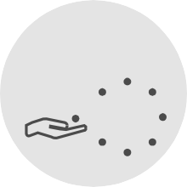



Three reasons for TOKEN appreciation
Market demand drives price increases
The future of virtual reality technology will continue to expand people's needs in the virtual “real” world, such as virtual travel, shopping, social, games, movies, dating and so on. iWorld shopping mall will serve as a trading platform that perfectly matches supply and demand. Customers have to pay IWDP to buy all goods and the only way to get IWDP is to use IWD to exchange in Bancor. The buying power of IWD in the secondary market will lead to the sharply increasing trend of IWD price.
Repurchase mechanism
iWorld team promises to repurchase IWD in the secondary market by 30% of the previous year's profit, which will promote IWD price.
Absolute value
The absolute value of money is determined by the "coin parity", which means that the gold content of a gold coin and the difficulty of casting determine its value. Usually, in the crypto area, the so-called coin parity is determined by the difficulty of mining.
However there is no mine in iWorld, the absolute value of AND is completely determined by the difficulty of
contribution.

Slide 8


iWorld is a GIS platform that utilizes blockchain as a solution.
iWorld is designed to combine blockchain's decentralized storage with VR/AR/HM, IOT and smart hardwares. Based on the real world of atomic physics, the unique Layer 4 solution is designed to build a decentralized virtual world. The physical assets and social rules of the atomic physics world will gradually map to the virtual world. All laws of physics will be completely broken and rebuilt in the virtual world, and human limitations will be completely broken. iWorld will become the mainstream lifestyle in the future. We will reconstruct a future world for the people of the future. In this virtual world, assets, social rules, physical laws, and personal identities are all redefined by the latecomers themselves. In iWorld, Anyone can be anything.

Slide 9












iWorld's blockchain mission: Make VR ecological and transparent again
The prosperity of the virtual economy will inevitably require the assets in the economic system to be guaranteed, confirmed and even redefined. The blockchain, as the infrastructure for value transmission, is also the basic guarantee for the identification and redefinition of digital assets, and is based on the blockchain. The issued crypto-asset (AND) uses blockchain to operate throughout the entire VR system.
I.O.T

Slide 10







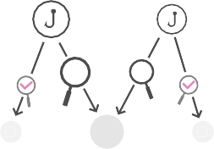
iWorld Network
Participant Roles
V
Validators
Secure the relay chain by staking DOTs, validating proofs from collators and participating in consensus with other validators.
Relay Chain
V
V
V
V
N
Nominators
Secure the relay chain by selecting good validators and staking DOTs.
N
N
V
V
V
V
C
Collators
Maintain parachains by collecting parachain transactions from users and producing state transition proofs for validators. They also monitor the network and prove bad behaviour to validators.
V
C
V
V
C
Fishermen
Final security frontier, they monitor the network and prove bad behaviour to validators.
!
!
V
V
V

Slide 11
iWorld's native token: Tokens will be released in the Genesis block.
Token Allocation
AND Token Allocation
Role of Token: The iWorld platform circulation medium (utility token)
Symbol: Token
Market Supply: 10,000,000,000 AND
Market Circulation: 7,000,000,000 AND
TOKEN initial sale
Emission Rate:
• 1st year: 15,000,000,000
• 2nd year: 1,000,000,000
• 3rd year: 500,000,000
Accepted Currencies: BTC/ETH/USDT
Token distribution: 6/4/2019
20%
50%
1,000,000,000
TOKEN
30%

Slide 12





iWorld's blockchain as a solution
The AND token serves 3 distinct purposes:
incentivises
Governance
Polkadot token holders have complete control over the protocol. All privileges, which on other platforms are exclusive to miners, will be given to the relay chain participants (DOT holders), including managing exceptional events such as protocol upgrades and fixes.
Operation
Game theory incentivizes token holders to behave in honest ways. Good actors are rewarded by this
mechanism whilst bad actors will lose their stake in the network. This ensures the network stays secure.
Bonding & Payment
New parachains are added by bonding tokens. Outdated or non-useful parachains are removed by removing bonded tokens. This is a form of Proof of Stake.
For further information on DOTs, please read our FAQ.

Slide 13
Roadmap
Polkadot is targeting an initial launch in 2019. Here’s how we plan to get there:
2019 Q3:
- Releasing iWorld’s Programming Language and its development environments
- Modification of interfaces and UX adjustment
- Establishing the Chinese version of official website of iWorld
- Developed Code Security Audit Toolkit and embedding iWorld Virtual Machine into the blockchain
- Initiation of project proposal within iWorld designated needs
- iWorld Token framework integration
- Intellectual property protection (patent and copyright for the development and brand name)
- Global marketing and PR campaign.
2019 Q4:
- Announcing beta version and official iWorld Wallet
- Improving the p2p network protocol to utilize the connection between nodes
- Integration of deep analytical tools and advanced calculation of metrics and conversions.
- Multi-localization and multi-language support.
- Complete the design and construction of the application architecture of first batch of personalized DApp identity
- Launch of the rating system
- Creation and audit of deploying smart contracts on DAG
2020 Q1
- Involvement of large brands and agencies.
- Complete the development of user privacy protection related content
- Launch of paid channels to attract the target audience (influencers and new companies) in Facebook, Twitter, Linkedin, etc
2020 Q2:
- iWorld surveying and mapping GIS system and blockchain service tool integration completion
- Governance structure ready: to release the official governance statutes
2020 Q3
- iWorld integrated DApp testnet completion
- Integration of use cases to co-develop with major cities in China
2020 Q4:
- Core community of iWorld platform to reach 100,000 total users

